Slide 1

Superbowl Ads Play-by-Play
Stats-Bomb

Slide 2
Table Of Contents
01
Introductions
02
Methods
03
Results & Metrics

Slide 3

Introduction
Charchit - MSIS
Samruddhi - MSBA
Sampoornaa - MSBA
Jordan - Ex-Football Player

Slide 4
Why Are Football Ads So Important?
Ideal platform for brands to showcase their products and services.
Notes:
130 m people watch it
people just watch it for the ads
it’s a annual event - there’s is a culture behind the event

Slide 5

130+ Million
People watch the Super Bowl every year
$7 Million
Dollar was spent Per 30 seconds of Ads
51
The total number of ads for this years superbowl

Slide 6
Methods
Data Source
Twitter
Data Splitting
Python
Data Cleaning
Domo ETL
Visualization
Domo
Notes:
We got the data from the competition, it was a huge file that needed to be splitted and cleaned up
We used python with Pandas to split up the code uploaded the code to Domo used domo for ETL (cleaning) and visualization Open Source - available in github linked in

Slide 7
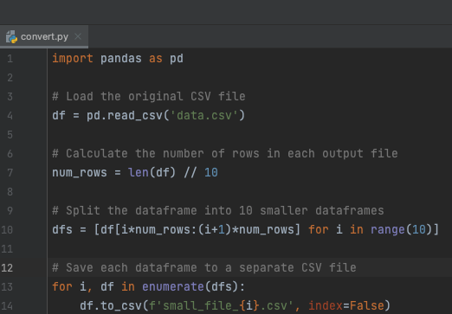
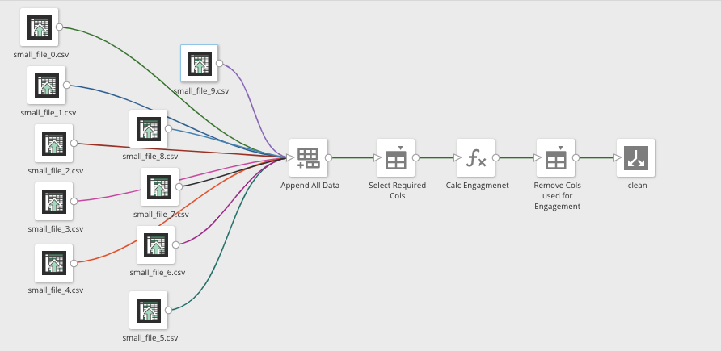
Methods
cont.
57
57
Notes:
Python - We splitted our data into 10 folds, created ETL with one data, created a visualization
Then added the data back on for ETL, we cleaned up data, wrote formulas and removed unnecessary colums

Slide 8
Metric Categories
Location
Celebrity Impact
Engagement
Keywords
Sensitivity
Time Series

Slide 9
Location Data
New York
California
Texas
Notes:
#1 New York
#2 Texas
#3 California

Slide 10
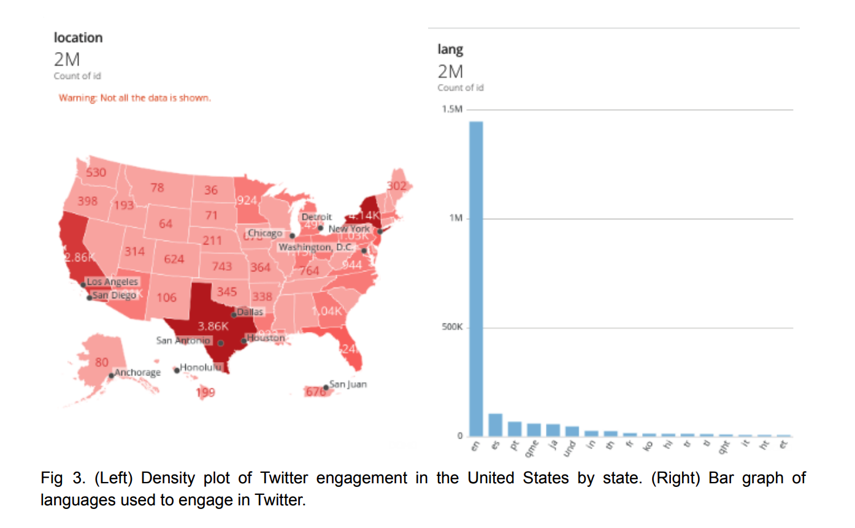
Location Data
Notes:
#1 New York
#2 Texas
#3 California

Slide 11

Engagement

Slide 12
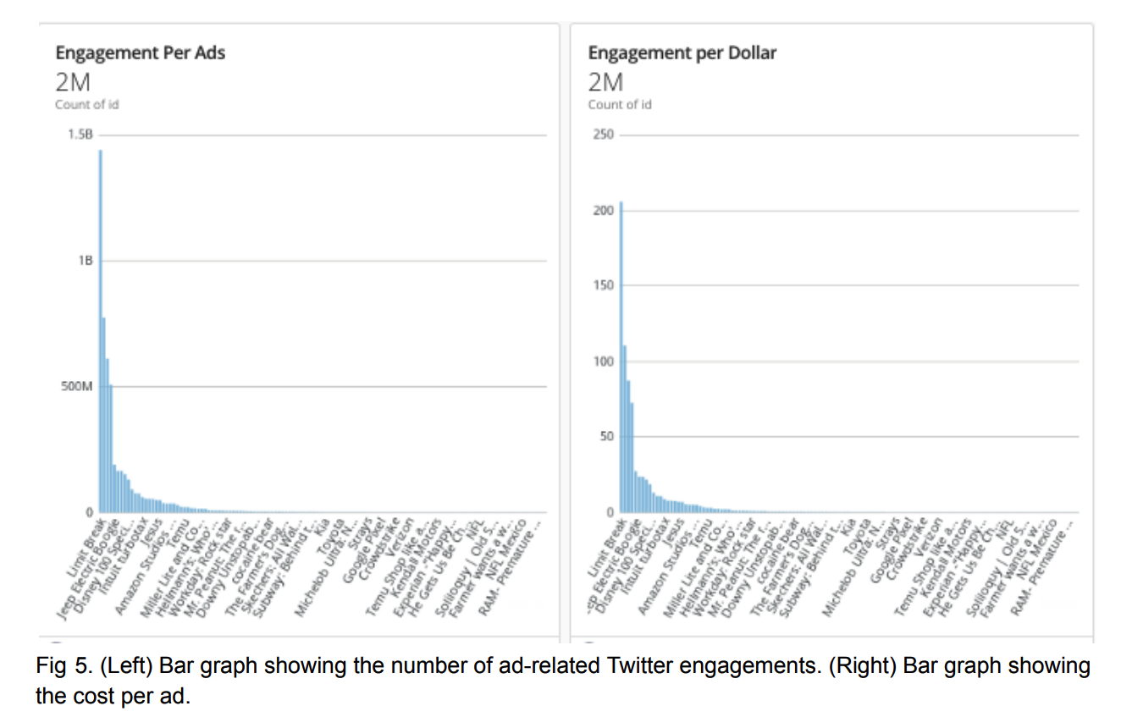
Engagement

Slide 13
Sensitivity
Don’t use unfavourable words
Controversial Celebs
Brand is impacted directly

Slide 14
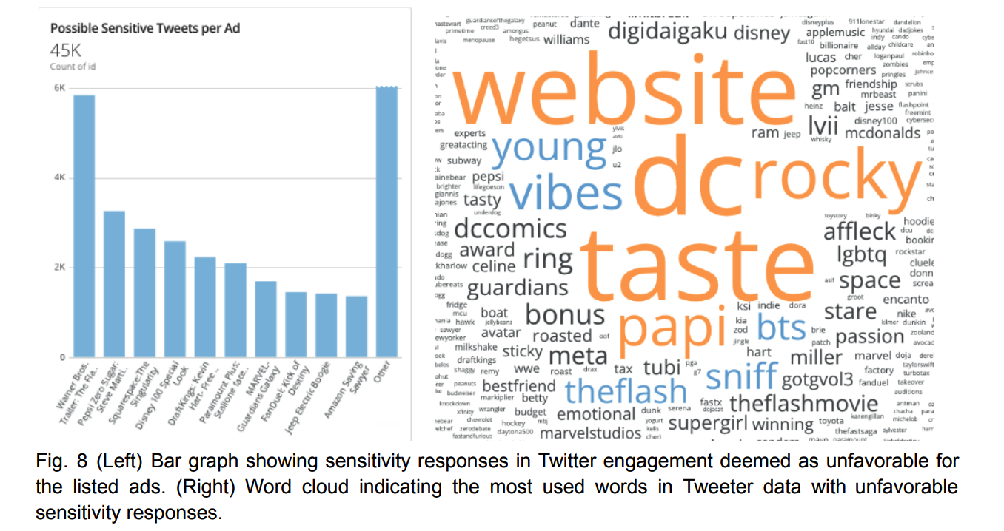
Sensitivity

Slide 15
Celebrity Impact
Having a celeb
Celeb Reputation
Rihanna
Ben Stiller
Sylvester Stallone
Erza Miller
Steve Martin
Erza Miller
Steve Martin

Slide 16
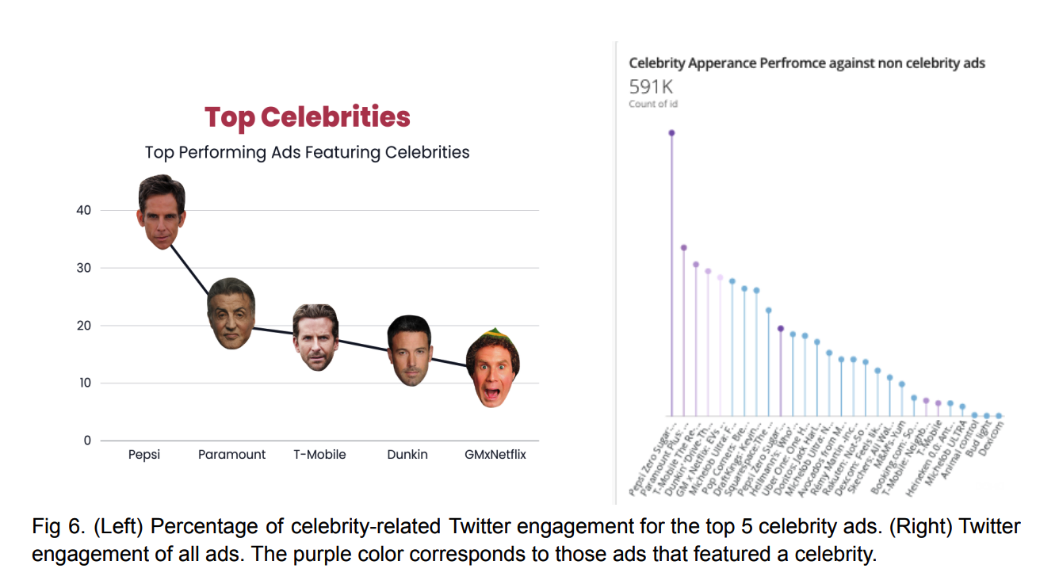
Celebrity Impact

Slide 17
Keywords
Good Keyword
Bad Keyword
Cellysweepstakes
Disney
Digidiagku
Website
DC
Young

Slide 18
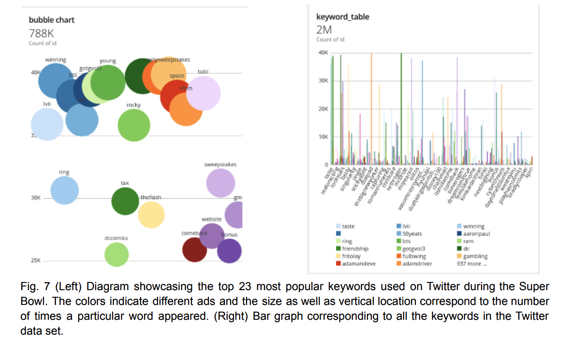
Keywords
Bad Keyword
Cellysweepstakes
Disney
Digidiagku

Slide 19
Time Series
Q3
Q4
Best Time To Show Ads
Worst Time To Show Ads

Slide 20
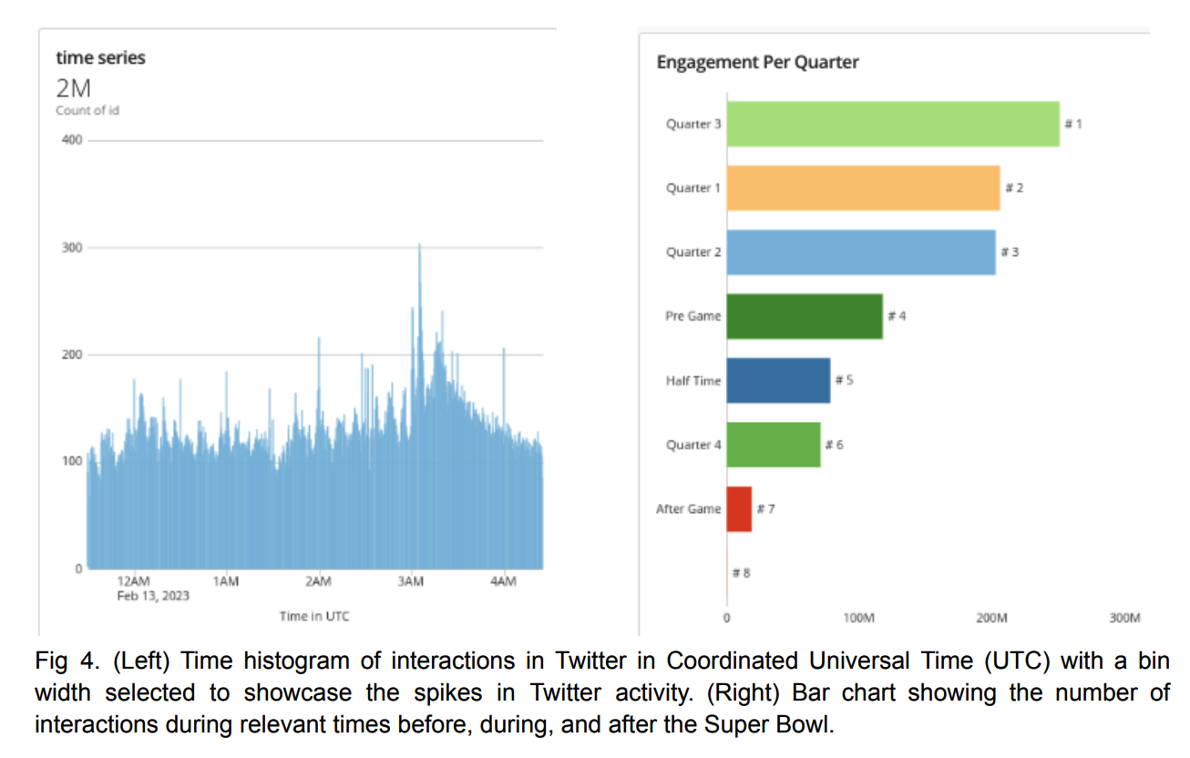
Time Series

Slide 21
What makes a great ad?
Celebrity
Timing
Avoid
Sensitive Content
Location

Slide 22
Conclusion
02
The significance of data analytics in the advertising sector
Geography, time series, interaction, celebrity presence, keywords
Questions

